Slide 1
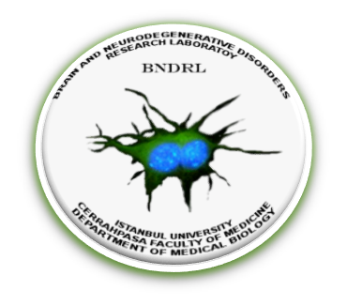
The clues for new roles of vitamin D and vitamin D receptor in neurodegeneration.
Vitamin D Workshop 2018
VITAMIN D, IN THE PREVENTION OF HEALTH DISPARITIES DURING ADULT LIFE
Erdinç Dursun & Duygu Gezen-Ak
ISTANBUL UNIVERSITY-CERRAHPASA
CERRAHPASA FACULTY OF MEDICINE
DEPARTMENT OF MEDICAL BIOLOGY
BRAIN AND NEURODEGENERATIVE DISORDERS RESEARCH UNIT
ISTANBUL - TURKEY
THESSALONIKI, GREECE
2018
Nothing to declare

Slide 2
The begining...
Last decade gave us the opportunity to investigate the role of vitamin D and its receptor in development and disorders of central nervous system.
Yet still the debate is going on validaiting the action of vitamin D and vitamin D receptor in brain
The aim of this talk is
To draw a picture of
What we have asked?
What we have proved?
What we have learned?
What still remains to be discovered? ☺ a lot...
in vitamin D basis of neurodegeneration

Slide 3
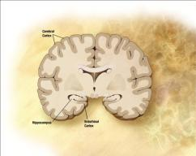
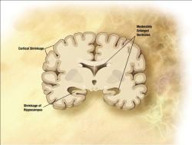
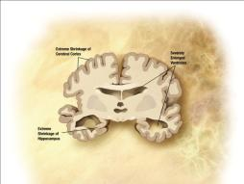
Alzheimer’s disease
Amyloid Plaques
Neurofibrillary Tangles
These pathological structures cause:
Distruption of axonal transport,
Distruption of signal transmission between neurons,
Distruption of neurotrophic factor synthesis
Distruption of neuronal calcium homeostasis
Induction of oxidative stress
Senile plaques ( Silver Staining):
Amyloid aggeragtions ( diffuse or dense )
stained dark brown.
NFT, hematoxylene eosin.
Intracytoplasmic dense fibrillary structures
(http://www-medlib.med.utah.edu/WebPath/CNSHTML/CNS090.html)
(http://www-medlib.med.utah.edu/WebPath/CNSHTML/CNS094.html)
Preclinic state
(Mild Alzheimer’s)
(Severe Alzheimer’s)

Slide 4
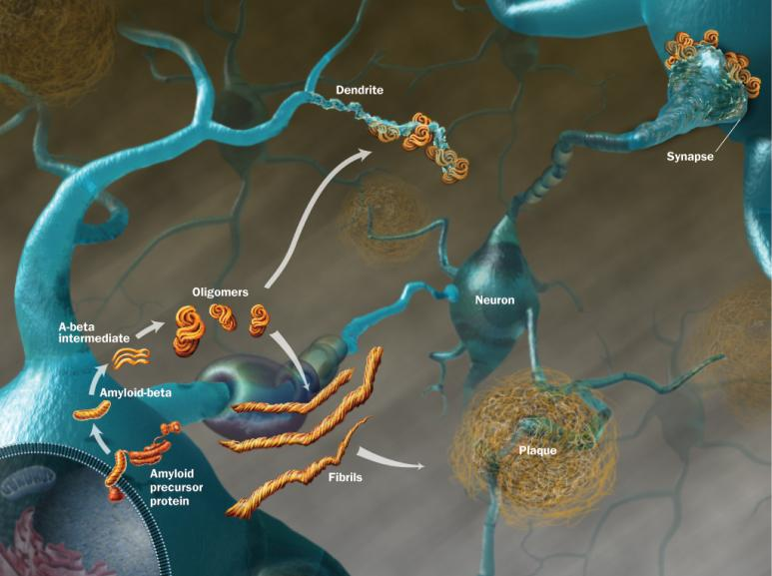
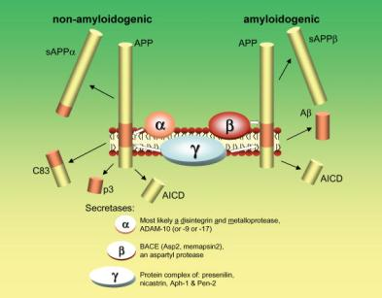
Amyloid Beta
Generated by the cleavage of APP via the secretases
4kDa, 39-43 aminoacid
Pearson HA et al J Physiol 2006;575:5-10.

Slide 5
Does vitamin D act in brain?

Slide 6
Vitamin D receptor gene (VDR)- Alzheimer’s disease
1992 Sutherland et al.: The hippocampi of the AD patients have decreased VDR mRNA expression.
2001 Paduslo et al.: linkage study; indicated a AD related risk locus on chromosome 12q. No sigificant gene reported but the locus involved VDR in addition to other genes.
2006-2011: the first studies indicating the relation between vitamin D deficiency and cognitive decline.
2007 Gezen-Ak et al.: Certian VDR polymorphisms increase the risk of developing AD 2.3 times.
2009 Beecham et al.: GWA study (including 550.000 SNPs) reported a AD associated novel locus at chromosome 12q13. They indicated that among other genes VDR is the most probabale candidate risk gene for AD given the data of Gezen-Ak study.
2012 Gezen-Ak et al.: VDR “TaubF” haplotype is more frequently seen in AD patients.

Slide 7
Genetic background of VDR-vitamin D pathway in neurodegenerative disorders
Association between VDR polymorphisms and Parkinson’s disease:
Butler MW, et al. (2011) Vitamin D receptor gene as a candidate gene for Parkinson disease. Ann Hum Genet 75, 201-210
Gatto NM et al. Vitamin D receptor gene polymorphisms and Parkinson's disease in a population with high ultraviolet radiation exposure. J Neurol Sci. 2015;352(1-2):88-93
Gezen-Ak D, et al (2016) GC and VDR SNPs and Vitamin D Levels in Parkinson's Disease: The Relevance to Clinical Features. Neuromolecular Med.
Association between Low density lipoprotein receptor-related protein 2 (LRP2 or megalin) the transporter of vitamin D at the plasma membrane and AD:
Vargas T, et al. (2010) A megalin polymorphism associated with promoter activity and Alzheimer’s disease risk. Am J Med Genet B Neuropsychiatr Genet 153B, 895-902.
Wang LL, et al. (2011) A single nucleotide polymorphism in LRP2 is associated with susceptibility to Alzheimer’s disease in the Chinese population. Clin Chim Acta 412, 268-270
Association between LRP2 (megalin) polymorphisms and cognitive decline
Beydoun MA, et al. (2012) Vitamin D receptor and megalin gene polymorphisms and their associations with longitudinal cognitive change in US adults. Am J Clin Nutr 95, 163-178.
Association between vitamin D binding protein (GC, VDBP) polymorphisms and Parkinson’s disease:
Gezen-Ak D, et al (2016) GC and VDR SNPs and Vitamin D Levels in Parkinson's Disease: The Relevance to Clinical Features. Neuromolecular Med.

Slide 8
Serum 25OHD levels

Slide 9
The relation between vitamin D and neurodegeneration
Vitamin D deficiency and cognitive performance (2006-2010)
Wilkins CH, Sheline YI, Roe CM, Birge SJ, Morris JC (2006) Vitamin D deficiency is associated with low mood and worse cognitive performance in older adults. Am J Geriat Psychiat 14, 1032-1040.
Annweiler C, Schott AM, Allali G, Bridenbaugh SA, Kressig RW, Allain P, Herrmann FR, Beauchet O (2010) Association of vitamin D deficiency with cognitive impairment in older women: cross-sectional study. Neurology 74, 27-32.
Vitamin D levels and cognitive decline (2009-2010)
Llewellyn DJ, Langa KM, Lang IA (2009) Serum 25- hydroxyvitamin D concentration and cognitive impairment. J Geriatr Psychiatry Neurol 22, 188-195.
Llewellyn DJ, Lang IA, Langa KM, Muniz-Terrera G, Phillips CL, Cherubini A, Ferrucci L, Melzer D (2010) Vitamin D and risk of cognitive decline in elderly persons. Arch Intern Med 170, 1135-1141.

Slide 10
Vitamin D deficiency and Alzheimer’s disease
Meta analysis: Serum 25OHD levels of AD patients are significantly lower than that of healthy controls!
Annweiler C. et al 2013. Low serum vitamin D concentrations in Alzheimer’s disease: A systematic reviewand meta-analysis. J Alzheimers Dis 33, 659-674.
Vitamin D deficiency increses the risk of developing AD and vascular dementia (VaD)!
Afzal S, et al. 2013. Reduced 25-hydroxyvitamin D and risk of Alzheimer’s disease and vascular dementia. Alzheimers Dement, doi: 10.1016/j.jalz.2013.05.1765.
A longitudinal study
30 years follow up
10,186 individulas
Vitamin D induces amyloid beta clearance of macrophages in AD patinets!
Masoumi A, et al. 2009 1alpha,25-dihydroxyvitamin D3 interacts with curcuminoids to stimulate amyloid-beta clearance by macrophages of Alzheimer’s disease patients. J Alzheimers Dis 17, 703-717.
Mizwicki MT, et al. 2011. Genomic and nongenomic signaling induced by 1,25(OH)2-vitamin D3 promotes the recovery of amyloid- phagocytosis by Alzheimer’s disease macrophages. J Alzheimers Dis 29, 51- 62.
Annweiler and Beauchet (AD-IDEA)
Annweiler C, et al. 2011 Alzheimer’s disease–input of vitaminD with mEmantine assay (AD-IDEA trial): Study protocol for a randomized controlled trial. Trials 12, 230
A combined treatment of both vitamin D and memantine (a well known AD drug).
Gave significantly better results compared with the memantine alone treated patients.

Slide 11
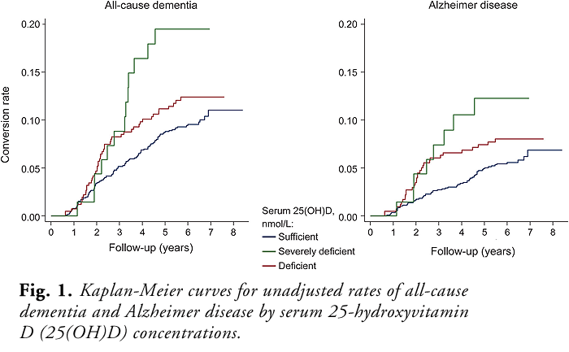
Littlejohns TJ. et al. Vitamin D and the risk of dementia and Alzheimer disease. Neurology. 2014
In elderly people, increased risk of developing AD or dementia is sigificantly associated with vitamin D deficiency!
University of Exeter Medical School, UK
David Llywellyn
1,658 elderly individulas
White Americans
Over 65 years old
No dementia
No signs of any cardiovascular disases
No stroke
6 years of follow up
171 individulas develop dementia
107 of them converts to AD
Conslusion:
Mild vitamin D deficiency increases the risk of developing dementia by 53% !
Severe vitamin D deficiency increases the risk of developing dementia by 125% !

Slide 12
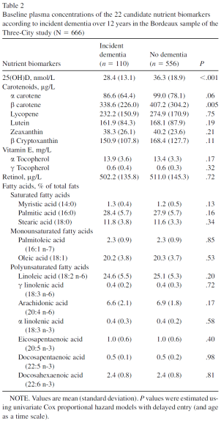
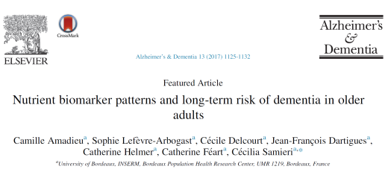
Nutrient Biomarkers for Dementia
666 individuals with no dementia
Plasma levels of 22 nutrient biomarkers
12 years follow up
Low levels of plasma vitamin D, karotenoids and polysaturated fats are associated with significantly high risk of dementia

Slide 13
CSF Vitamin D – CSF AMYLOID BETA CORRELATION
The correaltion of CSF vitamin D (25OHD) and CSF amyloid beta 1-42 levels in 50 patients with dementia (AD or Non-AD) (N=50; r = 0.3726, p=0.0077)
*Season adjusted 25OHD levels
Unpublished data

Slide 14
Growing evidence suggests a neurosteroid like properties for vitamin D. Yet sceptics are asking the same question more than a decade: Is it really there? In other words: (Does vitamin D have an action in brain as we know it?)

Slide 15
The cerebral expression of vitamin D-associated enzymes and receptors?

Slide 16
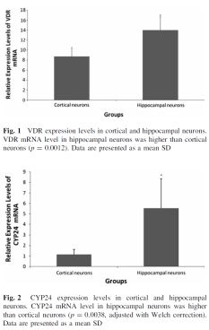
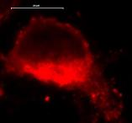
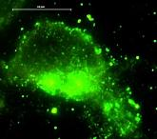
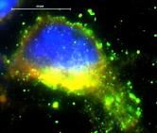
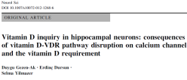
VITAMIN D RECEPTORS
VDR
Vitamin D, regulates over 1.000 genes in different tissues and in different conditions via a nuclear hormone receptor which is vitamin D receptor (VDR) and via its suggested membrane receptor (1,25MARRS)
Vitamin D receptor
Location: membrane lipid rafts?, cytoplasm and nucleus
Genomic function - Transcription factor (cytoplasmic or nuclear VDR)
Fast non genomic function - Induction of various signalling pathways (membrane VDR)
Membrane receptor (membrane associated rapid response steroid binding protein-1,25 MARRS), ERp57, Grp58, Pdia3
Location: membrane lipid rafts, ER and nucleus
Genomic function - Transcription factor
Fast non genomic function - Induction of various signalling pathways
Protein folding
CYP24
Magnification x100, I/3 filter, Alexafluor 488 tagged anti-VDR (green); TX filter, Alexafluor 568 tagged anti-1,25-MARRS (red). Overlay picture: VDR and 1,25-MARRS colocalization (yellow)
Notes:
CYP24

Slide 17
Long before us:
Bidmon et al., 1991; Musiol et al., 1992; Stumpf and O'Brien, 1987
Initial identification of the cells that contains VDR in the brains of rats and hamsters
Radiolabeled 1,25(OH)2D3 and autoradiography
The presence of the VDR was confirmed in the brains of mice, rats, chicks and humans
when a specific antibody against the VDR was developed
Eyles et al., 2005; Prufer et al., 1999; Sutherland et al., 1992; Veenstra et al., 1998; Walbert et al., 2001; Zanello et al., 1997.
In the adult rodent brain,
the VDR is located within different cell types, including
neurons, astrocytes (Brown et al., 2003; Cui et al., 2013; Eyles et al., 2005),
oligodendrocytes (Baas et al., 2000)
in multiple brain regions (Prufer et al., 1999; Veenstra et al., 1998).

Slide 18
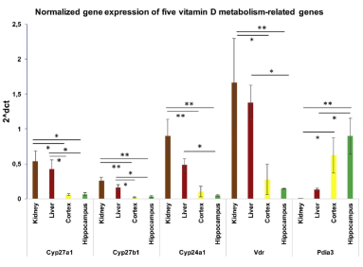
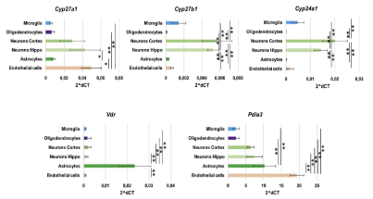
Landel study (2018)
Compared the transcript expression of
Cyp27a1, Cyp27b1, Cyp24a1, VDR and Pdia3
in purified cultures of astrocytes, endothelial cells, microglia, neurons and oligodendrocytes.
Observed that
Endothelial cells and neurons can possibly transform the inactive cholecalciferol into 25(OH)D3.
Neurons or microglia can metabolise 25(OH)D3 into 1,25(OH)2D3,
Alternatively,
1,25(OH)2D3 can induce autocrine or paracrine rapid non-genomic actions via PDIA3 whose transcript is abundantly expressed in all cerebral cell types.
Their data indicate that,
within the brain,
vitamin D may trigger major auto-/paracrine non genomic actions, in addition to its well documented activities as a steroid hormone.
Landel V. et al. Journal of Steroid Biochemistry and Molecular Biology 177 (2018) 129–134

Slide 19
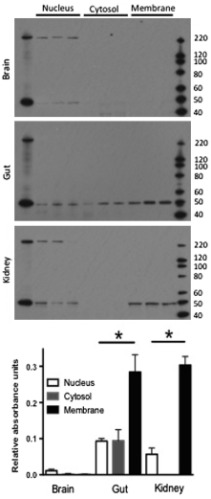
The subcellular location of VDR
Embryonic
Adult
2014. Eyles D.W. et al. demonstrated that,
in all embryonic tissues
VDR distribution is mostly nuclear,
however by adulthood
at least in the gut and kidney,
VDR presence in the plasma membrane is more prominent
(indicating some change in VDR function with the maturation of these tissues?)
The subcellular distribution of VDR in the embryo
did not appear to be altered by vitamin D deficiency
indicating that perhaps there are other mechanisms at play in vivo to stabilize this receptor in the absence of its ligand.
Eyles D.W. et al. Neuroscience 268 (2014) 1–9
Notes:
Embrionic

Slide 20
Subsection conclusion:
The location of VDR and PDIA3 is well established in CNS,
The location and action of vitamin D metabolism related enzymes including Cyp27a1, Cyp27b1, Cyp24a1 are demonstrated in major cell types of CNS
Vitamin D has major auto-/paracrine non genomic actions, in addition to its well documented activities as a steroid hormone in CNS

Slide 21
Cellular and animal models of neurodegeneration

Slide 22
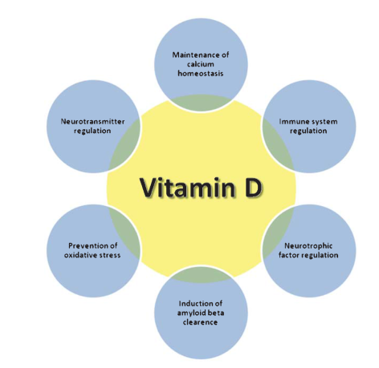
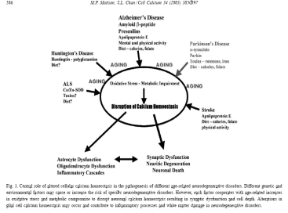
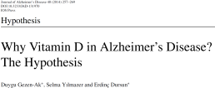

Slide 23
Amyloid beta
Disruption of neurotrophic support
Induces CaV1.2 ve 1.3 Suppresses calcium binding proteins
Supresses VDR
Increases 24OHase
Induces iNOS
Induces membrane damage/
apoptosis
Vitamin D
equilibrium in NGF secretion
Down-regulating L-type calcium channels
Protection from membrane damage/
apoptosis
Down-regulating iNOS expression
Up-regulating VDR expression
equilibrium in 24OHase expression

Slide 24
The corrected total cell fluorescence (CTCF) was determined and calculated as
CTCF = integrated density − (area of
selected cell × mean fluorescence of background readings)
Groups in 24h | The percentage of induction in amyloid beta 1-42 levels
VDR siRNA treated neurons | 189% induction
1,25MARRS (PDIA3) siRNA treated neurons | 205% induction
VDR siRNA + 1,25MARRS (PDIA3) siRNA treated neurons | 163% induction
Groups in 24h | The percentage of cells that express amyloid beta 1-42 higher than the cuttoff value
VDR siRNA treated neurons | 76% of the cells
1,25MARRS (PDIA3) siRNA treated neurons | 83% of the cells
VDR siRNA + 1,25MARRS (PDIA3) siRNA treated neurons | 68% of the cells
Groups in 48h | The percentage of induction in amyloid beta 1-42 levels
VDR siRNA treated neurons | 136% induction
1,25MARRS (PDIA3) siRNA treated neurons | 172% induction
VDR siRNA + 1,25MARRS (PDIA3) siRNA treated neurons | 136% induction
Groups in 48h | The percentage of cells that express amyloid beta 1-42 higher than the cuttoff value
VDR siRNA treated neurons | 59% of the cells
1,25MARRS (PDIA3) siRNA treated neurons | 74% of the cells
VDR siRNA + 1,25MARRS (PDIA3) siRNA treated neurons | 63% of the cells

Slide 25
the corrected total cell fluorescence (CTCF) was determined and calculated as
CTCF = integrated density − (area of
selected cell × mean fluorescence of background readings)
Groups in 24h | The percentage of reduction in amyloid beta 1-42 levels
10⁻⁷M 1,25(OH)₂D₃ treated neurons | 27% reduction
10⁻⁸M 1,25(OH)₂D₃ treated neurons | 50% reduction
Groups in 24h | The percentage of cells that express amyloid beta 1-42 lower than the cuttoff value
10⁻⁷M 1,25(OH)₂D₃ treated neurons | 79% of the cells
10⁻⁸M 1,25(OH)₂D₃ treated neurons | 95% of the cells
Groups in 48h | The percentage of reduction in amyloid beta 1-42 levels
10⁻⁷M 1,25(OH)₂D₃ treated neurons | 17% reduction
10⁻⁸M 1,25(OH)₂D₃ treated neurons | 21% reduction
Groups in 48h | The percentage of cells that express amyloid beta 1-42 lower than the cuttoff value
10⁻⁷M 1,25(OH)₂D₃ treated neurons | 75% of the cells
10⁻⁸M 1,25(OH)₂D₃ treated neurons | 79% of the cells

Slide 26
Vitamin D
induction
VDR
MARRS
suppression
time and concentration depended induction or suppression
ADAM10
BACE1
APP
NICASTRIN
PS1
PS2
APP PROCESSING
AMYLOID BETA 1-42
Pearson HA et al J Physiol 2006;575:5-10.

Slide 27
Subsection conclusion:
Vitamin D and VDR definetly have functions in CNS,
Their dysregulation in CNS has a high potential to cause or at least to be involved in
neurodegenerative, neurological or neuroinflamatory disorders

Slide 28
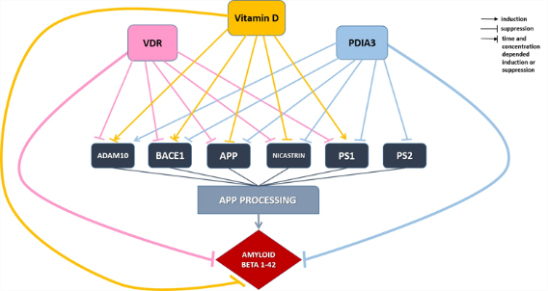
Neurodegeneration: Loss of function - death of a neuron What does vitamin D do in a neuron? How does it do that? Future Directions:

Slide 29
Novel properties of vitamin D and its receptors may emerge from the relation between amyloid beta and vitamin D?
Hypothesis 1
VDR is a transcription factor!
Amyloid beta 1-42 is a transcription factor?
Both of them regulates or at least acts on same genes or genes with similar functions?
A dysfunction in one of them will create an imbalance between them and may trigger pathways of neurodegeneration?
Hypothesis 2
VDR is located on neuronal plasma membrane!
VDR contributes to the action of the proteins involved in amyloidogenic or non- amyloidogenic pathways located in neuornal plasma membrane!
Vitamin D deficiency or VDR dysfunction may contribute to dysfunction of these pathways!

Slide 30
Hypotesis 1
Hypothesis 1
VDR is a transcription factor
Amyloid beta 1-42 is a transcription factor
Both of them regulates or at least acts on same genes or genes with similar functions
A dysfunction in one of them will create an imbalance between them and may trigger pathways of neurodegeneration
Is amyloid beta 1-42 present in nucleus?
Is amyloid beta 1-42 a transcrption factor?
Does amyloid beta 1-42 regulate the expression of neurodegeneration related genes?

Slide 31
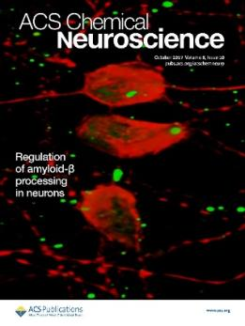

Slide 32
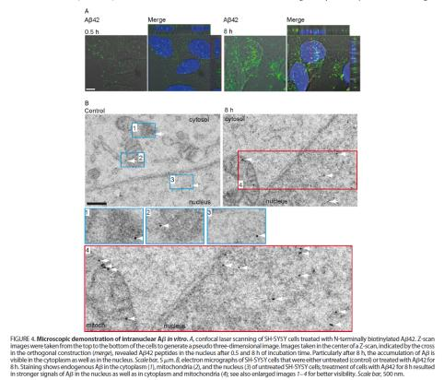

Slide 33
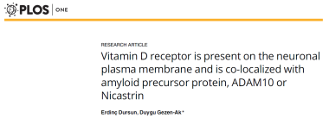

Slide 34
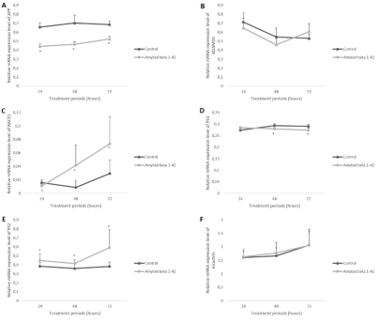
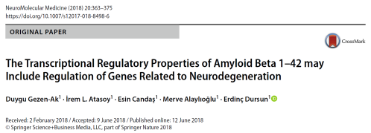
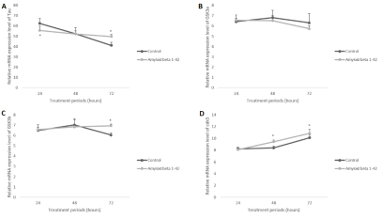
alpha secretase (ADAM10),
beta secretase (BACE1),
the gamma secretase complex (PS-1, PS-2, Nicastrin),
the substrate APP,
APOE (the significant risk factor for sporadic form of the AD),
TREM2 (recently indicated as a contributor to AD risk), the
NMDR genes Grin1, Grin2a, Grin2b, Grin2c, Grin2d, Grin3
PKCzeta as contributors of memory and learning,
key elements of tau pathology such as tau, GSK3α, GSK3β and Cdk5,
cholecalciferol metabolism-related enzyme 1α hydroxylase (1αOHase-encoded by CYP27b1 gene).
Needs confirmation with ChIP

Slide 35
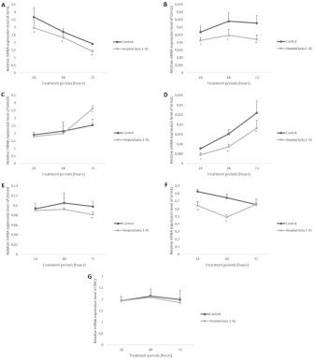
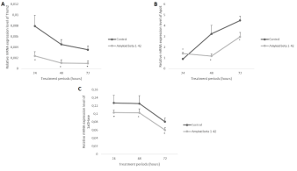
If amyloid beta 1-42 is a trancription factor then it may have important functions beyond todays knowledge.
If that is the case then treatments targeting total elimination of amyloid beta might be reconsidered!
High amount of amyloid beta 1-42 may increase its production working as a transcription factor and change the expression of neurodegeneration promoting genes?
We know that VDR regulates most of these genes that is foretold.
If VDR and amyloid beta 1-42 effects the transcription of the same genes then the absence of one may disrupt the balance in neurons.
Vitamin D deficiency or VDR dysfunction may promote this imbalance
The presence of amyloid beta 1-42 it self reduces VDR expression and vitamin D production and induces vitamin D catabolism.

Slide 36
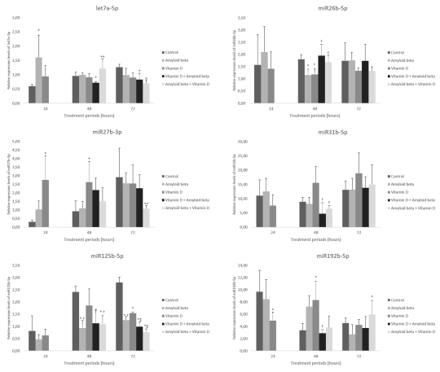
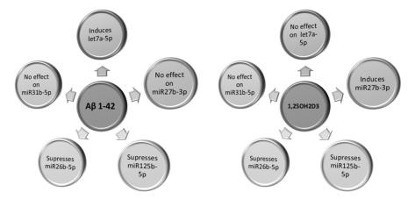
Besides transcriptional regulation... Vitamin D and amyloid beta have a cross talk over post transcriptional regulation via miRNAs
let-7a-5p, mir-26b-5p, mir-27b-3p, mir-31-5p, mir-125b-5p, mir-192-5p,
are suggested to be related with
vitamin D metabolism,
neuronal differentiation,
development
and memory

Slide 37
Healthy cell, healthy cell maintanence and aging
Adequate levels of Vitamin D,
Well functioning
VDR, 1,25MARRS/PDIA3
adequete levels? of Amyloid 1-42
Loss of cell maintanence, neurodegeneration
Low levels of Vitamin D,
Dysregulated
VDR, 1,25MARRS/PDIA3
High levels of Amyloid 1-42
If VDR and amyloid beta 1-42 effects the transcription or post-transcriptional regulation of the same genes then the absence of one may disrupt the balance in neurons.
Vitamin D deficiency or VDR dysfunction may promote this imbalance
Notes:
Heaalthy cell, healthy cell maintanence and aging

Slide 38
Hypothesis 2
Hypothesis 2
VDR is located on neuronal plasma membrane!
VDR contributes to the action of the proteins involved in amyloidogenic or non- amyloidogenic pathways located in neuornal plasma membrane!
Vitamin D deficiency or VDR dysfunction may contribute to dysfunction of these pathways!
Is VDR present in neuronal plasma membranes?
Is VDR colocalized with the proteins of amyloidogenic or non- amyloidogenic pathways?

Slide 39
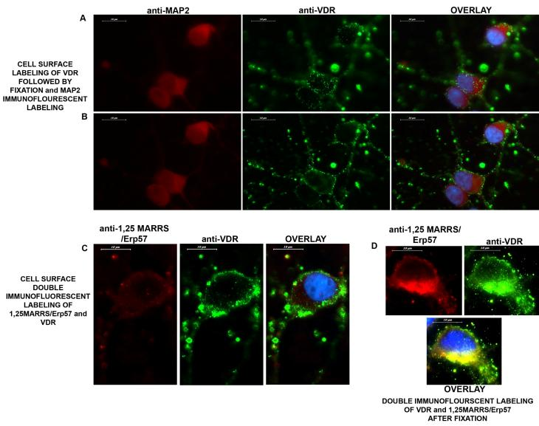
x63, I/3, Alexafluor 488, anti-VDR (green); TX, Alexafluor 568, anti- MAP2 (red) was used as neuronal marker.

Slide 40
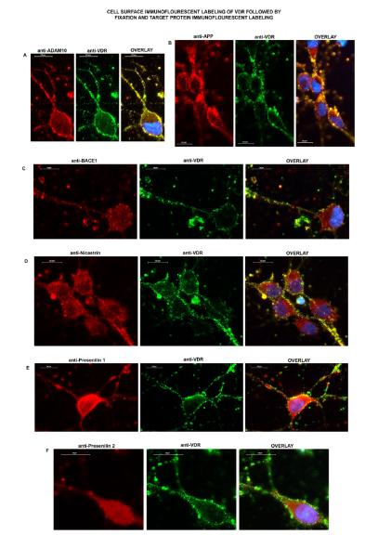

Slide 41
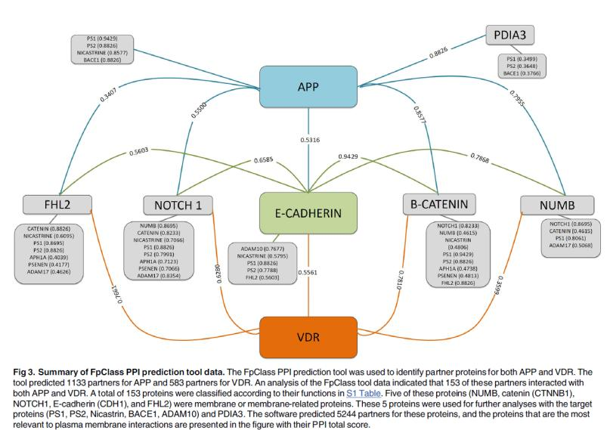
How does VDR translocates into plasma membrane?
Which proteins are interatcing with VDR directly in plasma membranes?
What does VDR do in neuronal plasma membrane?
Investigations are ongoing...

Slide 42
Energy metabolism, vitamin D and VDR?
The enzymes involved in vitamin D metabolism such as
CYP27A1 (25-hydroxylase),
CYP27B1 (1α-hydroxylase) and
CYP24A1 (24-hydroxylase),
are located in mitochondria.

Slide 43
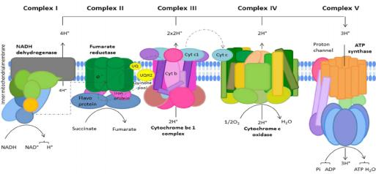
OXPHOS
Our results indicate that
vitamin D or the disruption of vitamin D pathway have effects on mitochondrial gene expression.
vitamin D receptor might have a role as a transcription factor in mitochondria.
vitamin D deficiency or the disruption of vitamin D pathway might cause mitochondrial dysfunction which is accepted as one of the major reason in the development of neurodegenerative disorders.
MT-ND1
MT-ND2
MT-ND3
MT-ND4
MT-ND4L
MT-ND5
MT-ND6
MT-CO1
MT-CO2
MT-CO3
CYTB
ATP 6
ATP 8

Slide 44
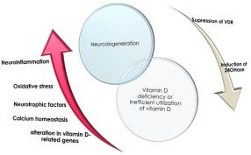
Conclusion
The location of vitamin D receptors or vitamin D metabolism related enzyemes is well established in CNS,
Vitamin D and VDR definetly have functions in CNS,
Their dysregulation in CNS has a high potential to cause or at least to be involved in
neurodegenerative, neurological or neuroinflamatory disorders
Vitamin D has major auto-/paracrine non genomic actions, in addition to its well documented activities as a steroid hormone in CNS
Vitamin D and VDR might be a part of signal relaying complex in neuronal plasma membrane
Vitamin D and VDR may regulate gene expression together with amyloid fragments
The balance in such regulation might be a key for preventing neurodegeneration
Vitamin D and VDR regulate mitochondiral gene expression and thus energy metabolism

Slide 45
BRAIN AND NEURODEGENERATIVE DISORDERS RESEARCH LAB
The reviewed studies of BNDRL funded by,
The Scientific and Technological Research Council of Turkey (TUBITAK)
Project No:
115S438
214S585
214S586
and
Research Fund of Istanbul University
Project No:
ONAP-21712
ONAP-28651
27781
55157
51454
32605
26645
24360

